Slide 1

Community building exercise

Slide 2
Community
Connections
Gifts
Notes:
Setup for community exercise – we’re heavily trained to see negatives, gaps, to help, to fix. Going to take a break from that now and see what happens.
Sit with two other people you don’t know – in a triangle, no barriers, knees maximum nine inches apart.
Trios – take it in turns to answer the question ‘why is it important for you to be here’ (or – advanced version – ‘what crossroads are you at right now’). They can be as personal as they’re comfortable with. The other two take in in turns to deepen the enquiry: ‘and why is that important to you?’ repeatedly – and must refrain from offering help, advice, or asking specific questions. At the end of the exercise, each participants tells the others something they have appreciated about them. Recipient of compliment must say ‘thanks very much, I enjoyed hearing that’ (advanced version: ‘…please tell me some more’).
Builds quite deep connections, quickly, and links to purpose – they’re not here ‘because they are on the course’ but for a deeper reason.

Slide 3
Basic:
Why is it important for you to be here today?
Advanced:
What cross-roads are you at right now?
Deepening question:
And why is that important to you?
Alternative:
That’s interesting – tell me more about that?

Slide 4
Basic:
Thank you very much, I enjoyed hearing that…
Advanced:
…please, tell me more!

Slide 5
Why is it important
for you to be here today?
Notes:
Ask the question to the group to reiterate their purpose

Slide 6
We welcome follow-up and conversation!
Benjamin P. Taylor
Chief Executive, Public Service Transformation Academy
& Managing Partner, RedQuadrant
+44 (0)7931317230
www.publicservicetransformation.org
We offer:
The 24-module Leading Transformation ‘mini MBA’
The RedQuadrant Way tool shed
Commissioner! The Simulation
The Cabinet Office Commissioning Academy
Local Transformation and Place-Based Systems Leadership Academies
The days after – a learning community to build back better

Slide 7
Public Service: State of Transformation 2019
report and survey www.publicservicetransformation.org/2019/06/state-of-transformation-report-2019/
2019 conference helping each other out of crisis www.publicservicetransformation.org/2019/07/state-of-transformation-2019-conference/

Slide 8
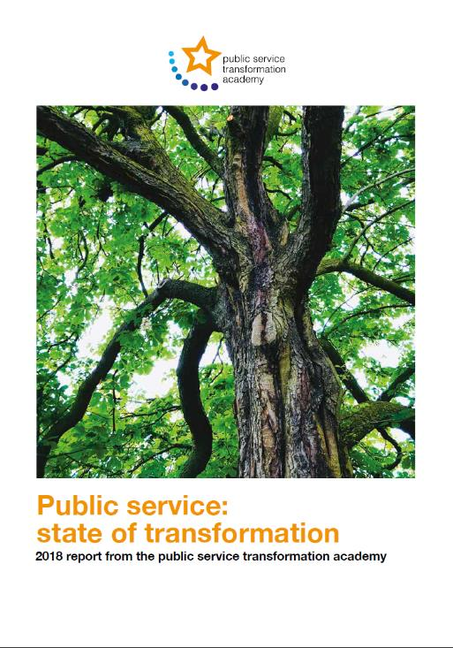
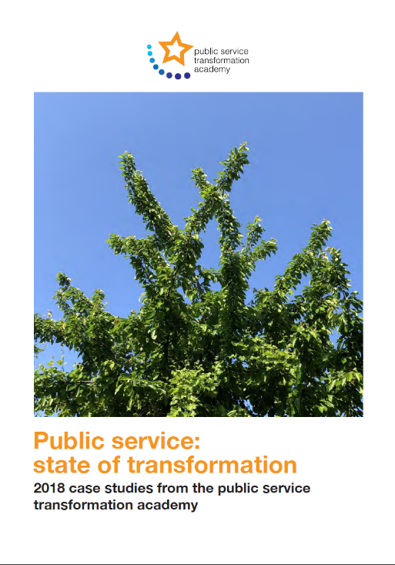
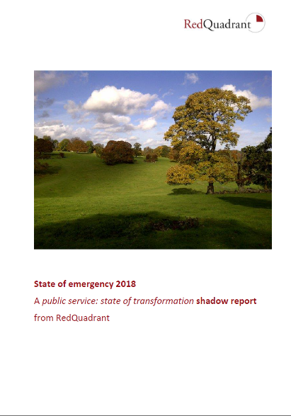
Public Service: State of Transformation 2018
think pieces: https://www.publicservicetransformation.org/wp-content/uploads/2018/05/public-service-state-of-transformation-2018-report-from-the-public-service-transformation-academy-e-version.pdf
case studies: https://www.publicservicetransformation.org/wp-content/uploads/2018/05/2018-case-studies-public-service-state-of-transformation-from-the-public-service-transformation-academy-e-version-ALPHA2-1.pdf
RedQuadrant shadow report – State of Emergency: http://redquadrant.com/media/98355/state-of-emergency-the-redquadrant-state-of-transformation-shadow-report.pdf
2018 conference, it doesn't have to be this way - full notes and other materials all available here: https://www.publicservicetransformation.org/2018/05/state-of-transformation-report/
Notes:
Our findings are published in two reports (and a third accompanies them) covering the current state of public service transformation, what it really could be – and examples of what, at its best, it is.

